Slide 1
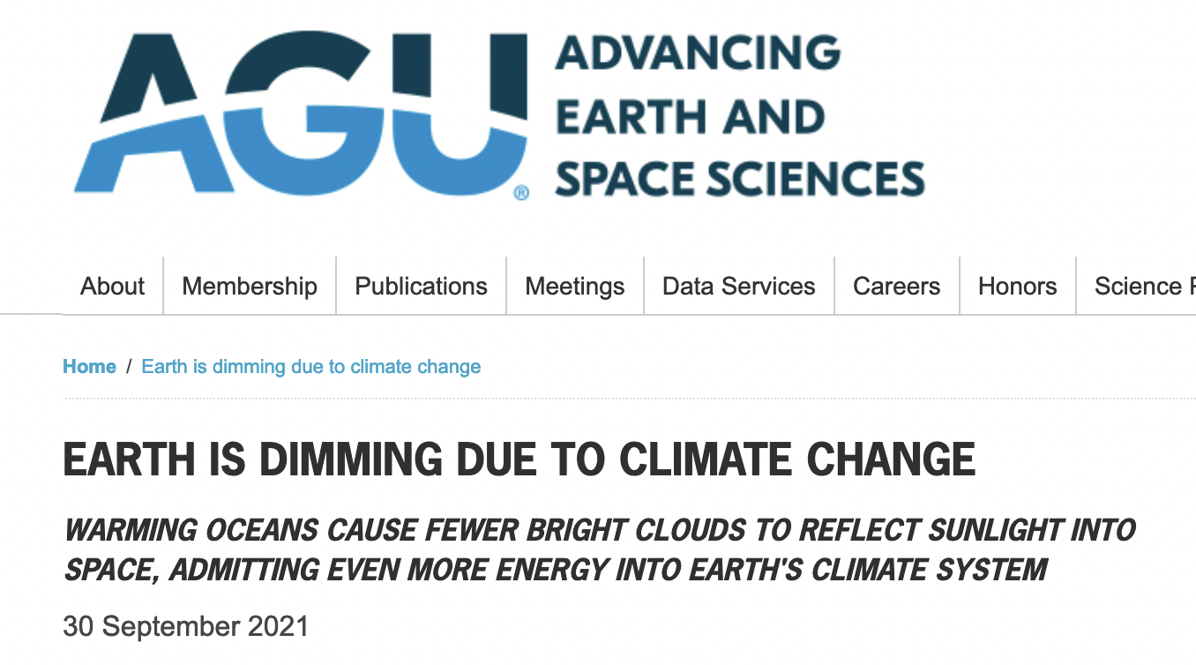
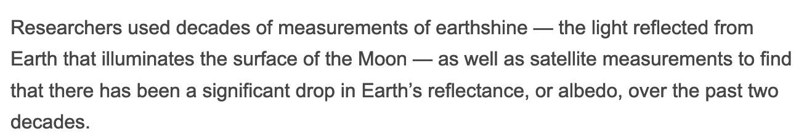
Inferring albedo from earthshine
But … what’s earthshine?
https://news.agu.org/press-release/Earth-is-dimming-due-to-climate-change

Slide 2
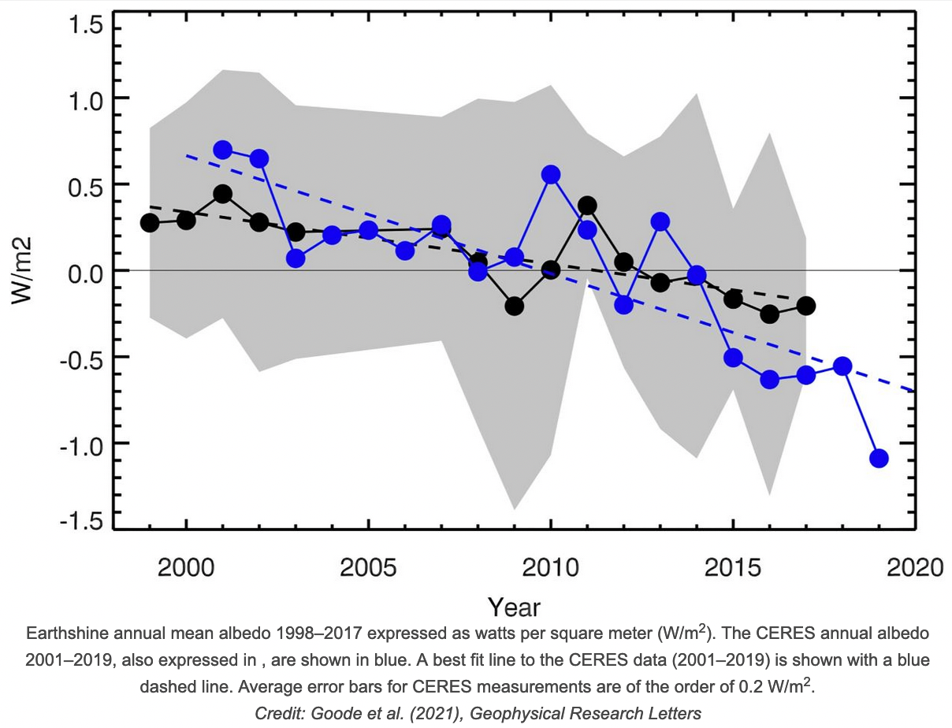
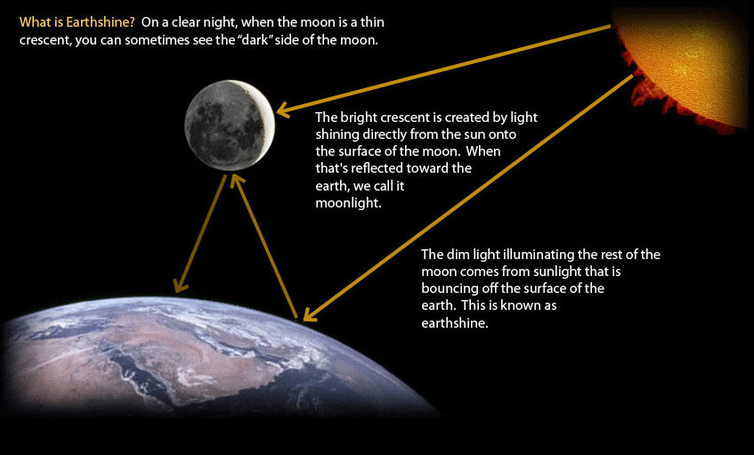
Inferring albedo from earthshine
From earthshine measurements (W/m²), Earth’s albedo is inferred.

Slide 3
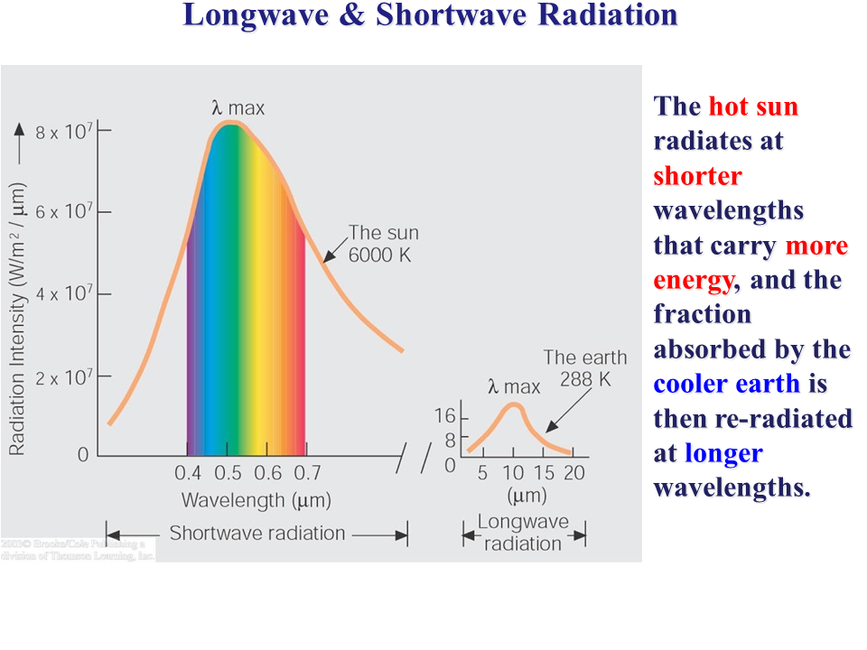
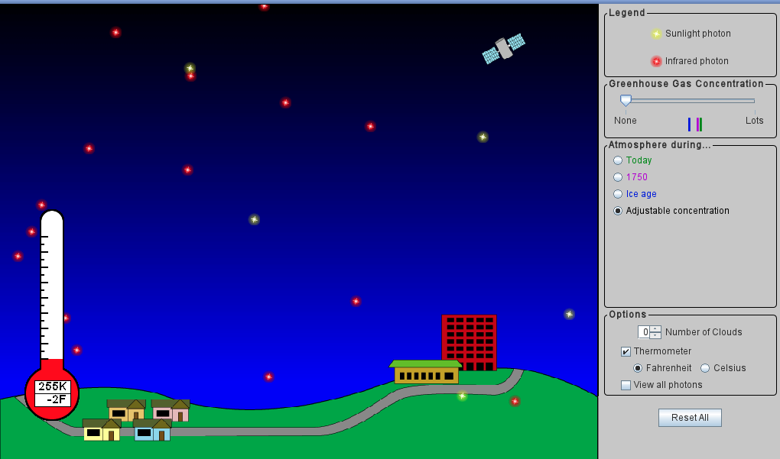
About that PhET simulator: Principle of radiative balance
Yellow photons represent shortwave radiation from the sun.
https://phet.colorado.edu/sims/cheerpj/greenhouse/latest/greenhouse.html?simulation=greenhouse
https://www.sliderbase.com/spitem-1155-2.html

Slide 4
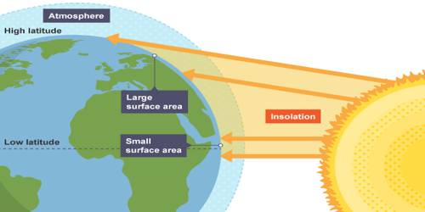
About that PhET simulator: Principle of radiative balance
Yellow photons represent shortwave radiation from the sun.
The intensity of the shortwave light you would perceive depends on:
Whether it’s day or night
Where you are on the planet
https://phet.colorado.edu/sims/cheerpj/greenhouse/latest/greenhouse.html?simulation=greenhouse
http://earthshinefoundation.org/images/whatisearthshine.jpg

Slide 5
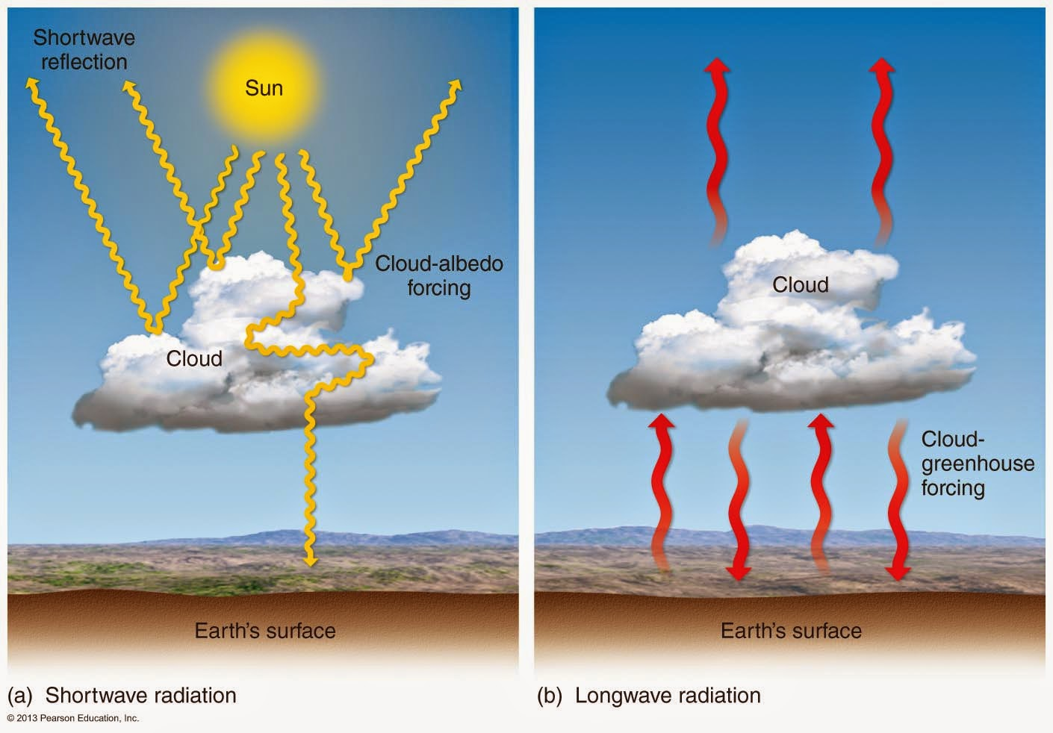
About that PhET simulator: Principle of radiative balance
Yellow photons represent shortwave radiation from the sun.
The amount of shortwave energy absorbed by Earth depends on:
Cloudiness
Ground reflectivity
https://phet.colorado.edu/sims/cheerpj/greenhouse/latest/greenhouse.html?simulation=greenhouse

Slide 6
About that PhET simulator: Principle of radiative balance
Red photons represent longwave radiation emitted by Earth’s surface (also by the atmosphere, your hands, any solid object).
https://phet.colorado.edu/sims/cheerpj/greenhouse/latest/greenhouse.html?simulation=greenhouse

Slide 7
About that PhET simulator: Principle of radiative balance
Red photons represent longwave radiation emitted by Earth’s surface (also by the atmosphere, your hands, any solid object).
The intensity of the longwave light emitted by an object depends on:
The temperature of the object
Temperature of the atmosphere
It also matters how easily photons get past the earth and out to space
https://phet.colorado.edu/sims/cheerpj/greenhouse/latest/greenhouse.html?simulation=greenhouse

Slide 8
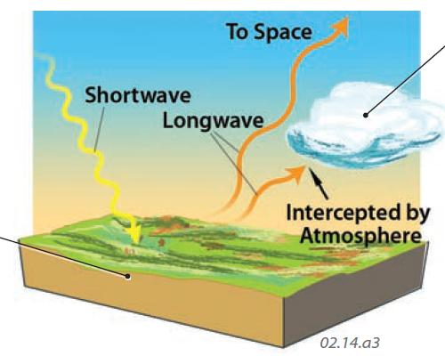
Shortwave and longwave
https://geography.name/wp-content/uploads/2019/06/22.jpg

Slide 9
Net radiative flux is the balance between shortwave (incoming) and longwave (outgoing)
Net radiative flux is zero, so Earth is in radiative balance.
https://phet.colorado.edu/sims/cheerpj/greenhouse/latest/greenhouse.html?simulation=greenhouse

Slide 10
Net radiative flux is the balance between shortwave (incoming) and longwave (outgoing)
Earth is too cold, so net radiative flux is positive. Earth will heat up!
https://phet.colorado.edu/sims/cheerpj/greenhouse/latest/greenhouse.html?simulation=greenhouse

Slide 11
Net radiative flux is the balance between shortwave (incoming) and longwave (outgoing)
Earth is too hot, so net radiative flux is negative. Earth will cool down!
https://phet.colorado.edu/sims/cheerpj/greenhouse/latest/greenhouse.html?simulation=greenhouse

Slide 12
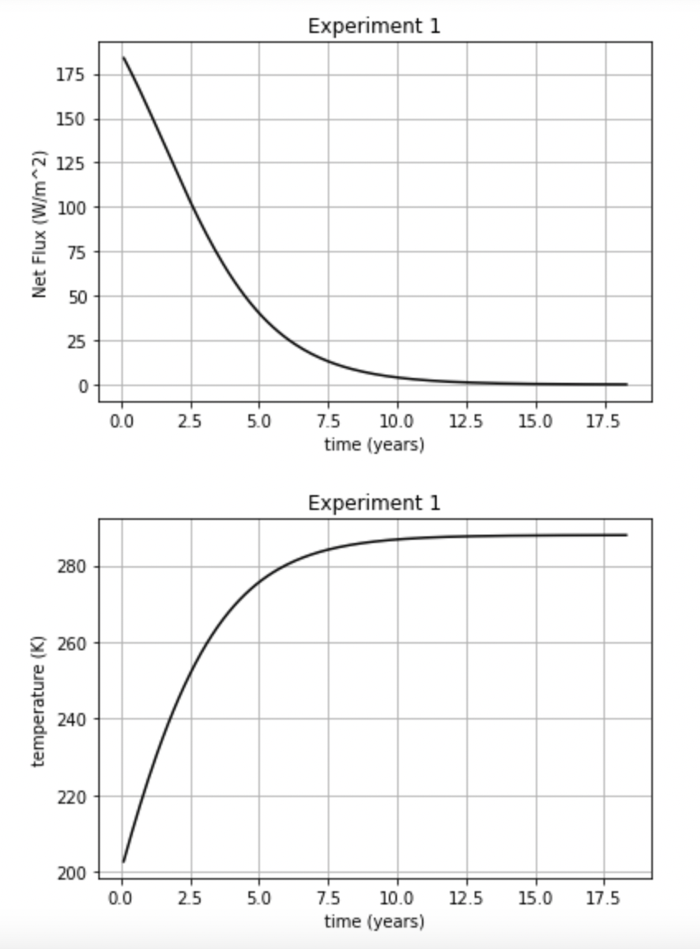
The idea of homeostasis
Here, did the earth start out too hot or too cold? Was the initial flux positive or negative? Did the earth heat up or cool down as a result?

Slide 13
The idea of homeostasis
Here, did the earth start out too hot or too cold? Was the initial flux positive or negative? Did the earth heat up or cool down as a result?
Earth started out too cold, so net radiative flux was positive. So the earth heated up!

Slide 14
The idea of homeostasis
Here, did the earth start out too hot or too cold? Was the initial flux positive or negative? Did the earth heat up or cool down as a result?
Heating up increased the longwave radiated to space, eventually ending in balance (“homeostasis”).

Slide 15
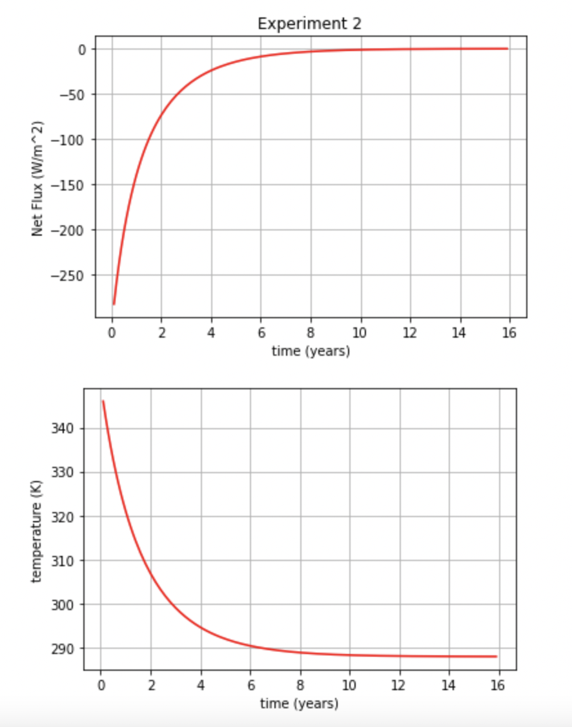
The idea of homeostasis
Here, did the earth start out too hot or too cold? Was the initial flux positive or negative? Did the earth heat up or cool down as a result?

Slide 16
The idea of homeostasis
Here, did the earth start out too hot or too cold? Was the initial flux positive or negative? Did the earth heat up or cool down as a result?
Earth started out too hot, so net radiative flux was negative. So the earth cooled down!

Slide 17
The idea of homeostasis
Here, did the earth start out too hot or too cold? Was the initial flux positive or negative? Did the earth heat up or cool down as a result?
Cooling down reduced the longwave radiated to space, eventually ending in balance (“homeostasis”).

Slide 18
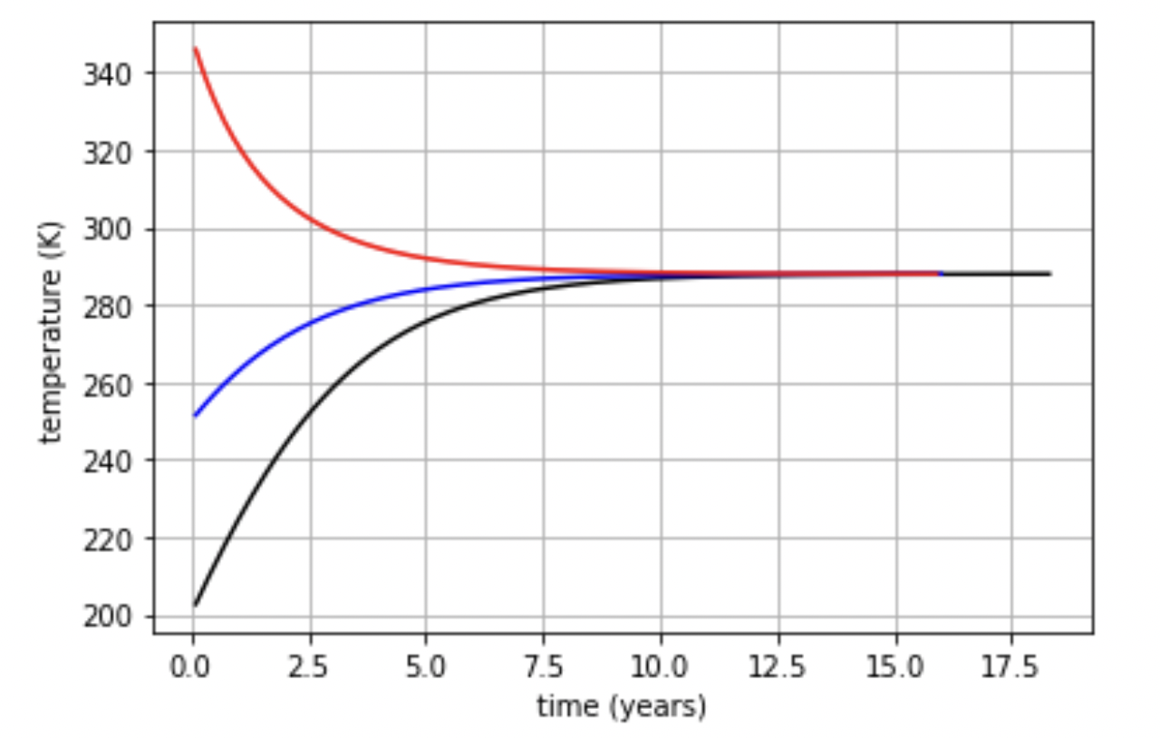
The beautiful thing about homeostasis
Earth has a self-correcting mechanism! (So do all planets, actually.)
To simulate this, we’ll need to have a way to march through time (left to right in this graph), calculate a flux at each step, and adjust Earth’s temperature accordingly.
To do that, we need to put together While loops and If blocks.

Slide 19
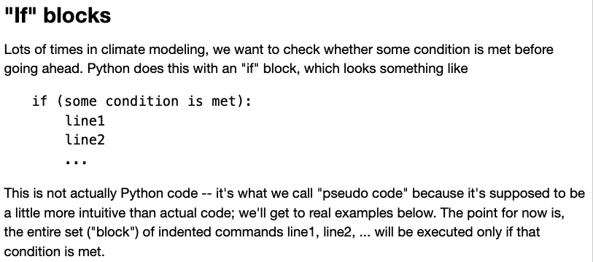
“If” blocks

Slide 20
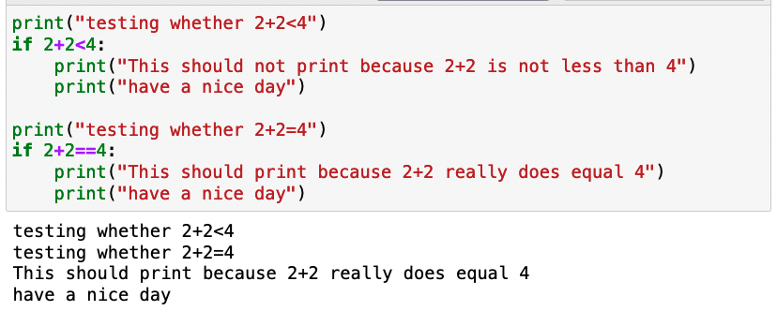
Example of an “If” block

Slide 21
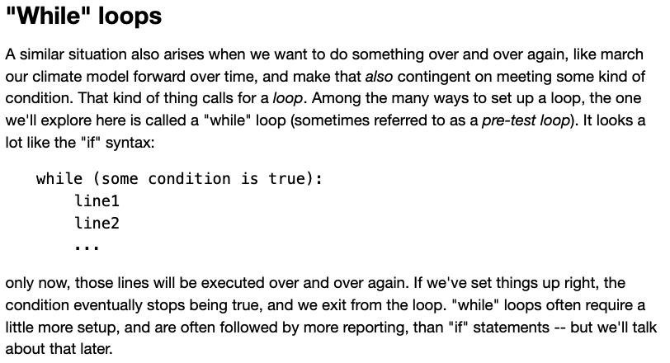
“While” loops

Slide 22
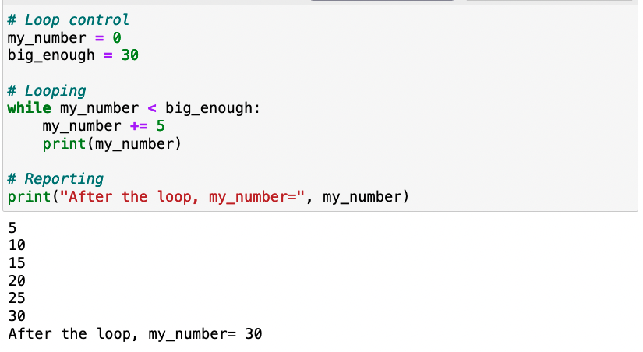
Example of a “While” loop

Slide 23
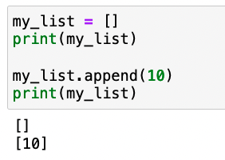
Building up lists by appending

Slide 24
Building up lists by appending

Slide 25
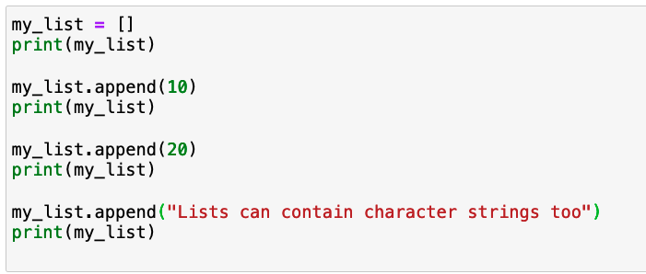
Building up lists by appending

Slide 26
This loop prints stuff out, but doesn’t save anything

Slide 27
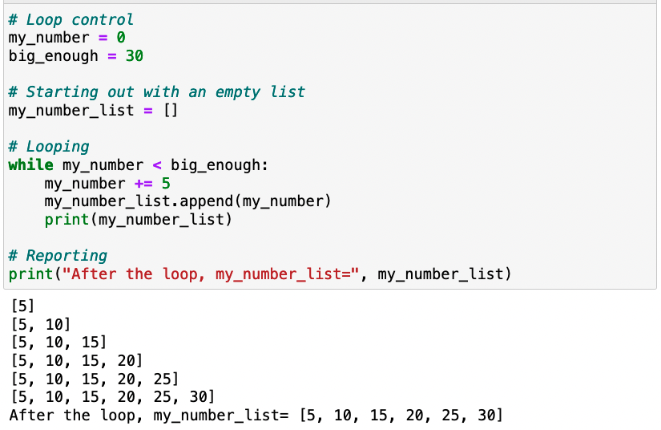
This loop prints stuff out and saves it in a list by appending!

Slide 28
This loop prints stuff out and saves it in a list by appending!

Slide 29
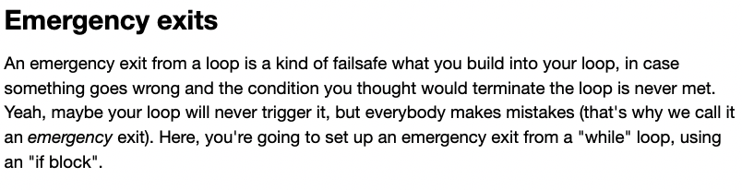
Emergency exits (from a loop)

Slide 30
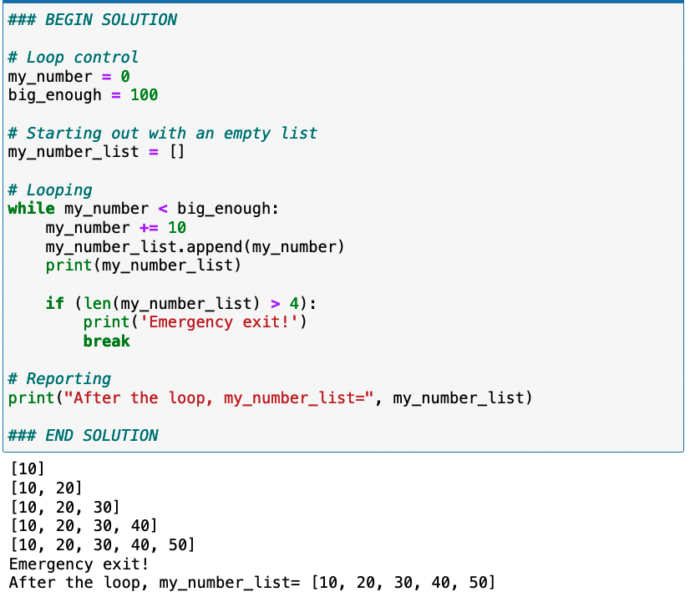
Example of an emergency exit

Slide 31
Terminating homeostasis
At first, the temperature changes a lot with each time step. After a while, however, it changes less and less.
The While loop in our code will say, when the temperature change is small enough, call it quits.

Slide 32
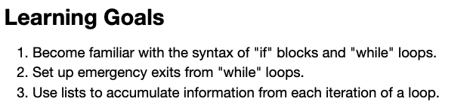
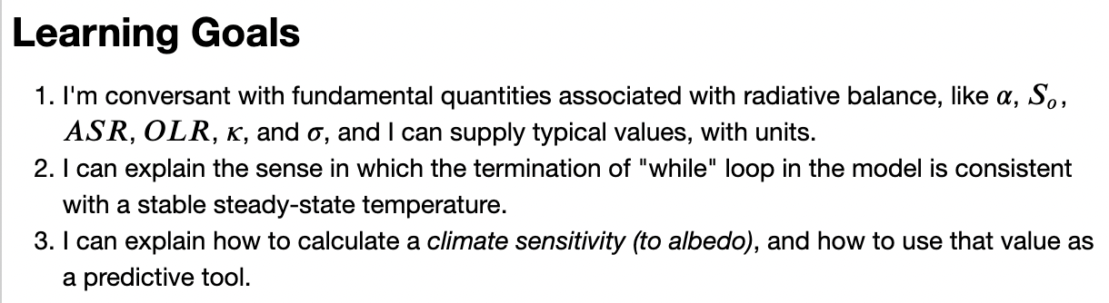
Summary of learning goals

